Slide 1

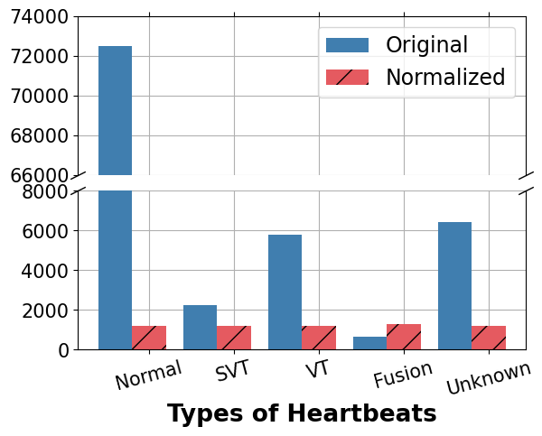
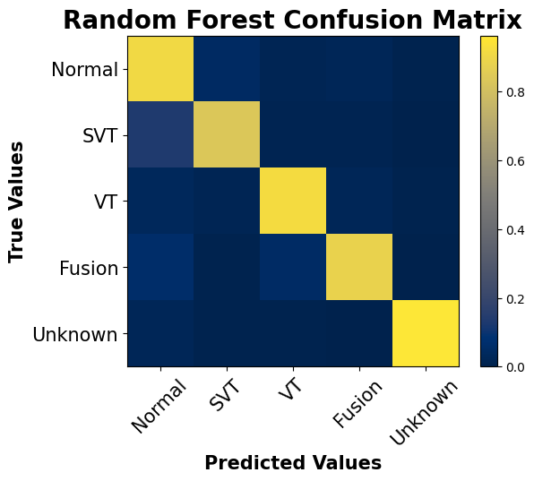
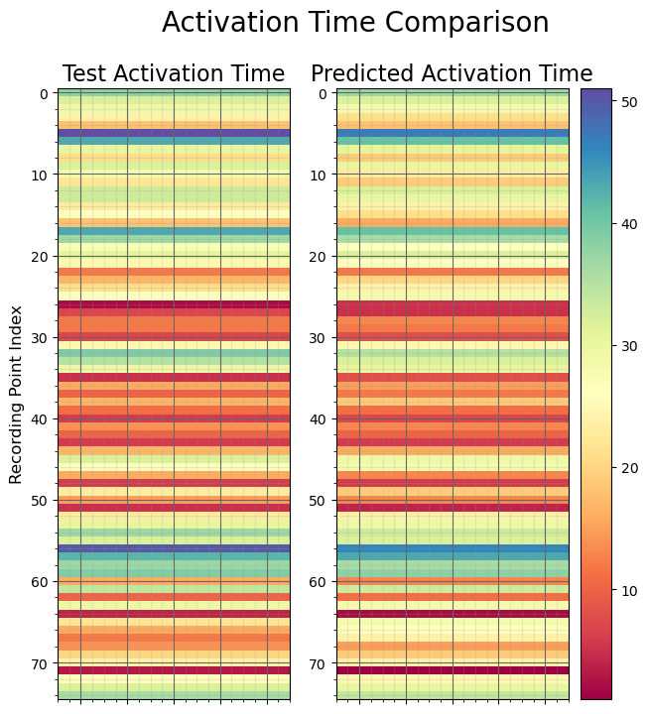
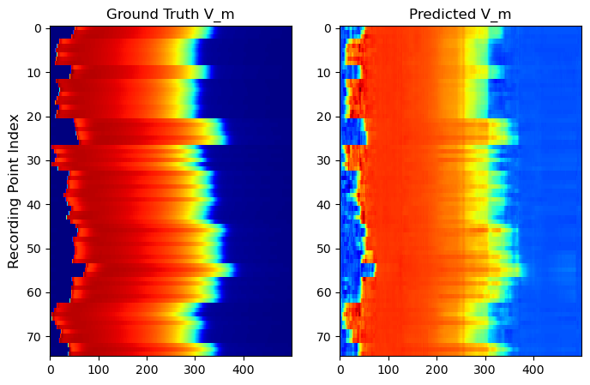
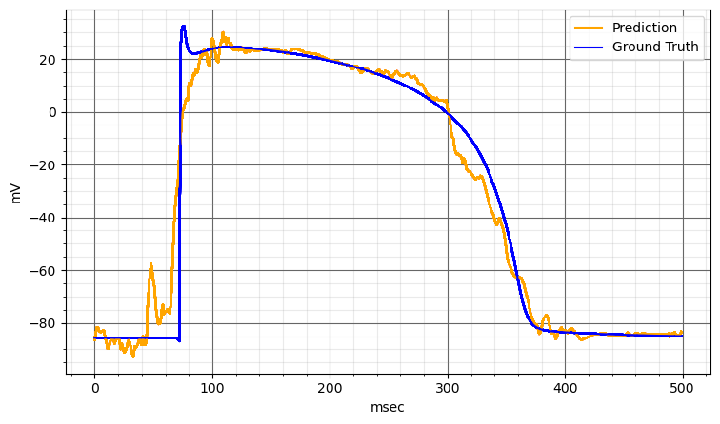
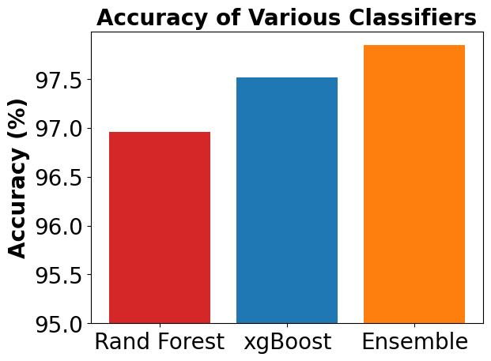
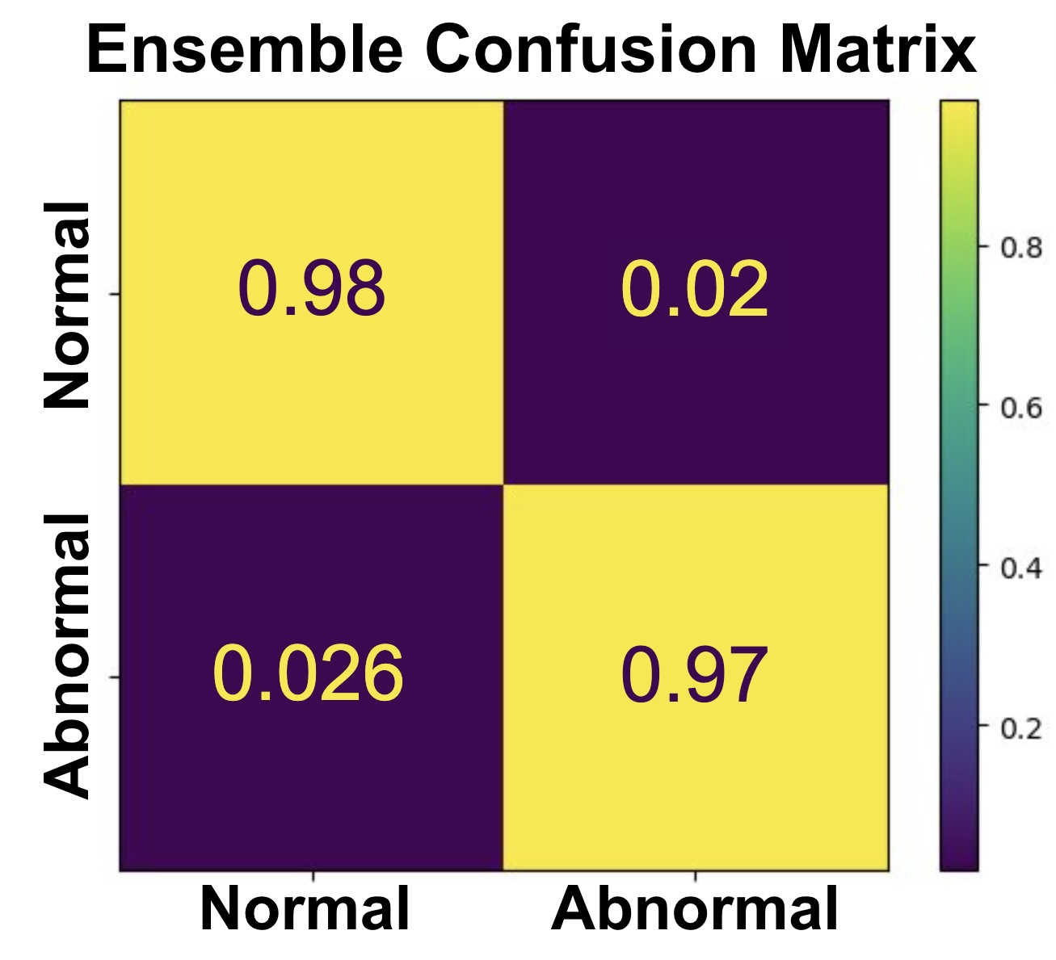
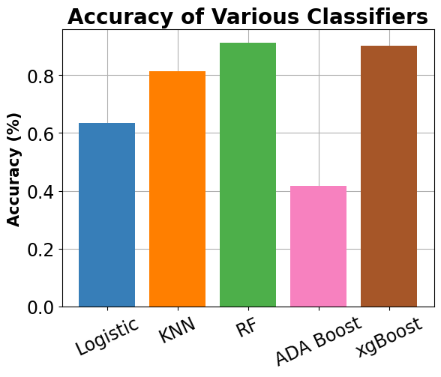
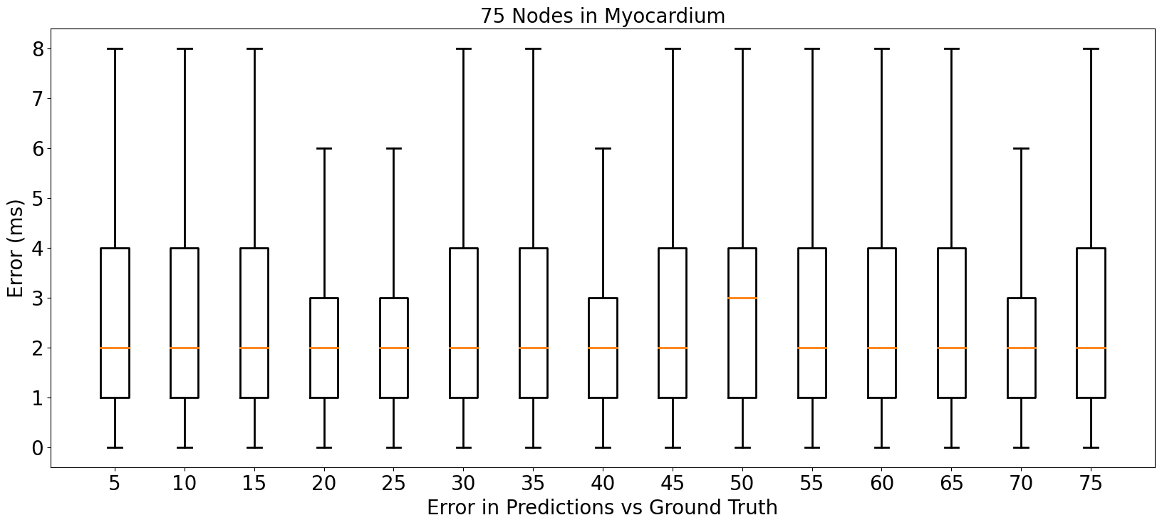
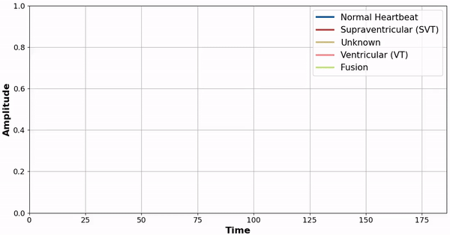
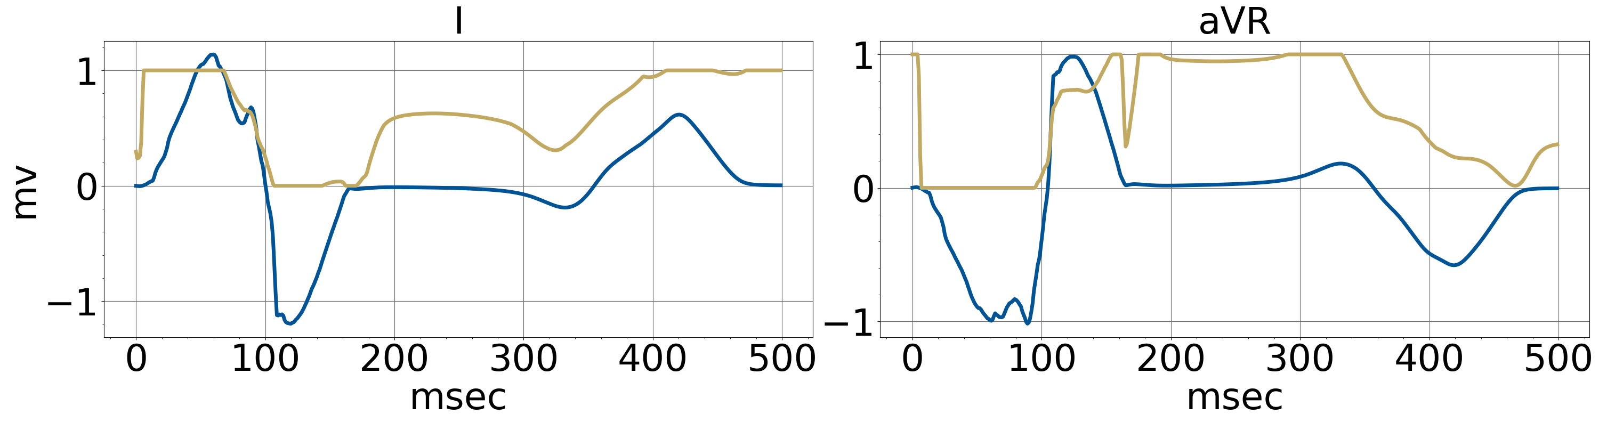
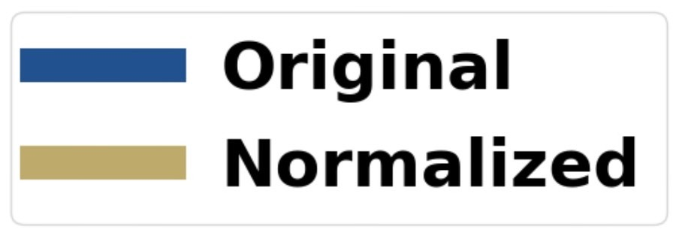
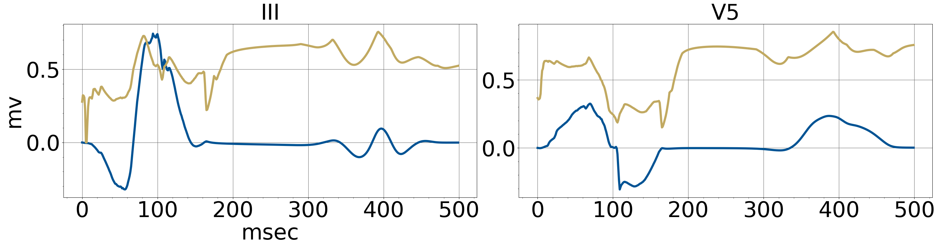
Neural Networks For The Heart!
Our contact information!
Team 6: Space Jam
Our contact information!
Dhawal Modi¹, Nikhil Narasimhan², Bhoomika Khatri³, Blake Hoff¹
¹University of California – Merced, ²University of California – Riverside, ³Case Western Reserve University
Electrocardiograms are non-invasive detectors of electrical signals from the heart that propagate through the torso. However, data for ECGs and spatial-temporal activation maps of the heart is expensive and difficult to obtain. We used supervised machine learning techniques to accurately classify normal versus abnormal heartbeats based on ECG readings as well as the type of abnormalities that the readings reflected. We then reconstructed the spatial-temporal activation map of the heart by using deep learning techniques to create the activation potential map of each of the 75 nodes in the myocardium and their corresponding activation times.
ECG Reading Classification
Using multiple models, we predicted the classification of 21892 ECGs for 5 different types of heartbeats.
The best model that we found was Random Forest with 91% accuracy and the best sensitivity of all the models
The worst prediction was Normal (predicted value) to Supraventricular (true value).
Accuracy of Classifiers: Normal vs Abnormal Heartbeats
A Confusion Matrix of Ensemble for Abnormal and Normal Labels
Reconstructing Transmembrane Potential Curves and Activation Times
CONCLUSIONS
Normalization of the 12-Lead ECG Readings using Min-Max Scaling.
The Ensemble of Random Forest and XgBoost Classifiers achieved 98% accuracy in predicting normal vs abnormal heartbeats.
Our 1D SqueezeNet model accurately predicted the activation time of each of the 75 nodes in the myocardium, incurring an average error of 2.5 msec.
Our custom 1D SqueezeNet with residual connections achieved high accuracy in Transmembrane Potential reconstruction, with a Pearson correlation coefficient of 0.9746.
1D CNNs are very good for sequence transduction problems! Low parameters allow for efficient training too!
Visualization of the Different Types of Heartbeat Labels in MIT-BIH Dataset
Acknowledgements: Thank you to the Lawrence Livermore National Laboratory for letting us take part in the Data Science Challenge and experiencing work at a national laboratory.
This work performed under the auspices of the U.S. Department of Energy by Lawrence Livermore National Laboratory under Contract DE-AC52-07NA27344.

